Slide 1
Increasing productivity amid stable nutrient regmines in Rhode Island Lakes and Reservoirs
NALMS 2019 Burlington VT
Jeff Hollister, Q Kellogg, Betty Kreakie, Stephen Shivers, Elizabeth Herron, Linda Green, Bryan Milstead, and Art Gold

Slide 2
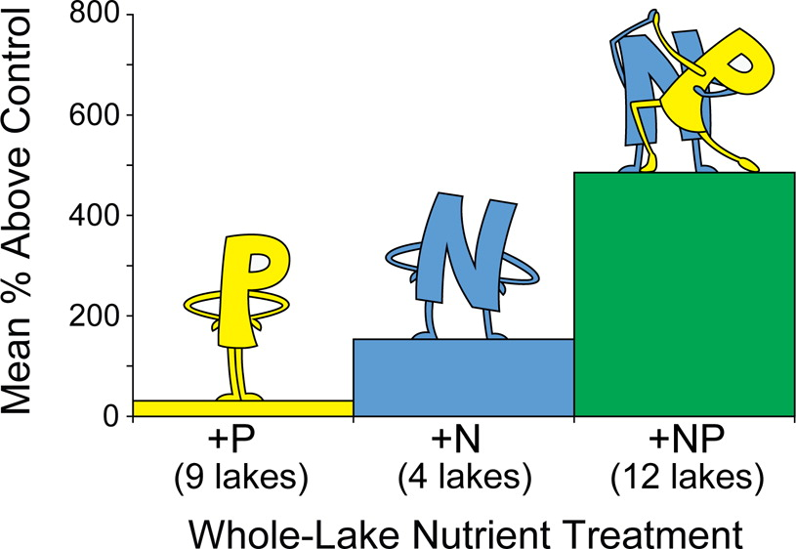
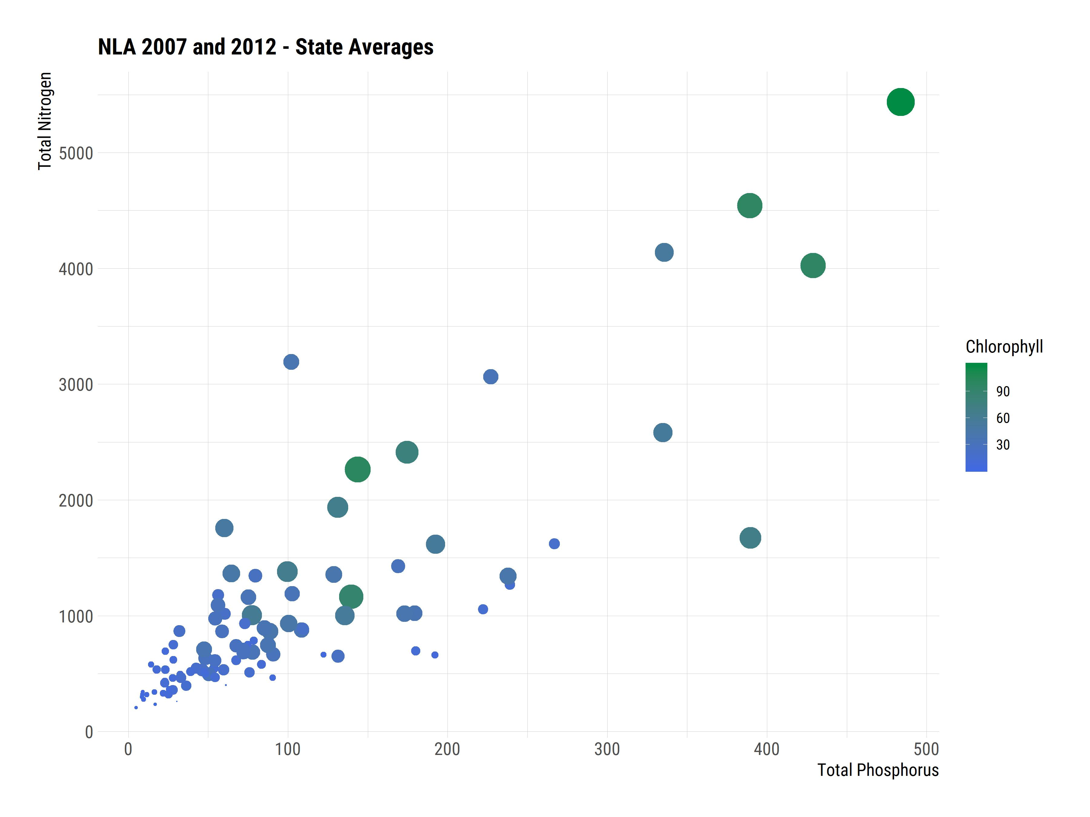
What drives changes in lake productivity?
Nutrients
Temperature
Other things
Paerl et al. 2016. It Takes Two to Tango: When and Where Dual Nutrient (N & P) Reductions Are Needed to Protect Lakes and Downstream Ecosystems. Environ. Sci. Tehnol. 50:20. https://doi.org/10.1021/acs.est.6b02575

Slide 3
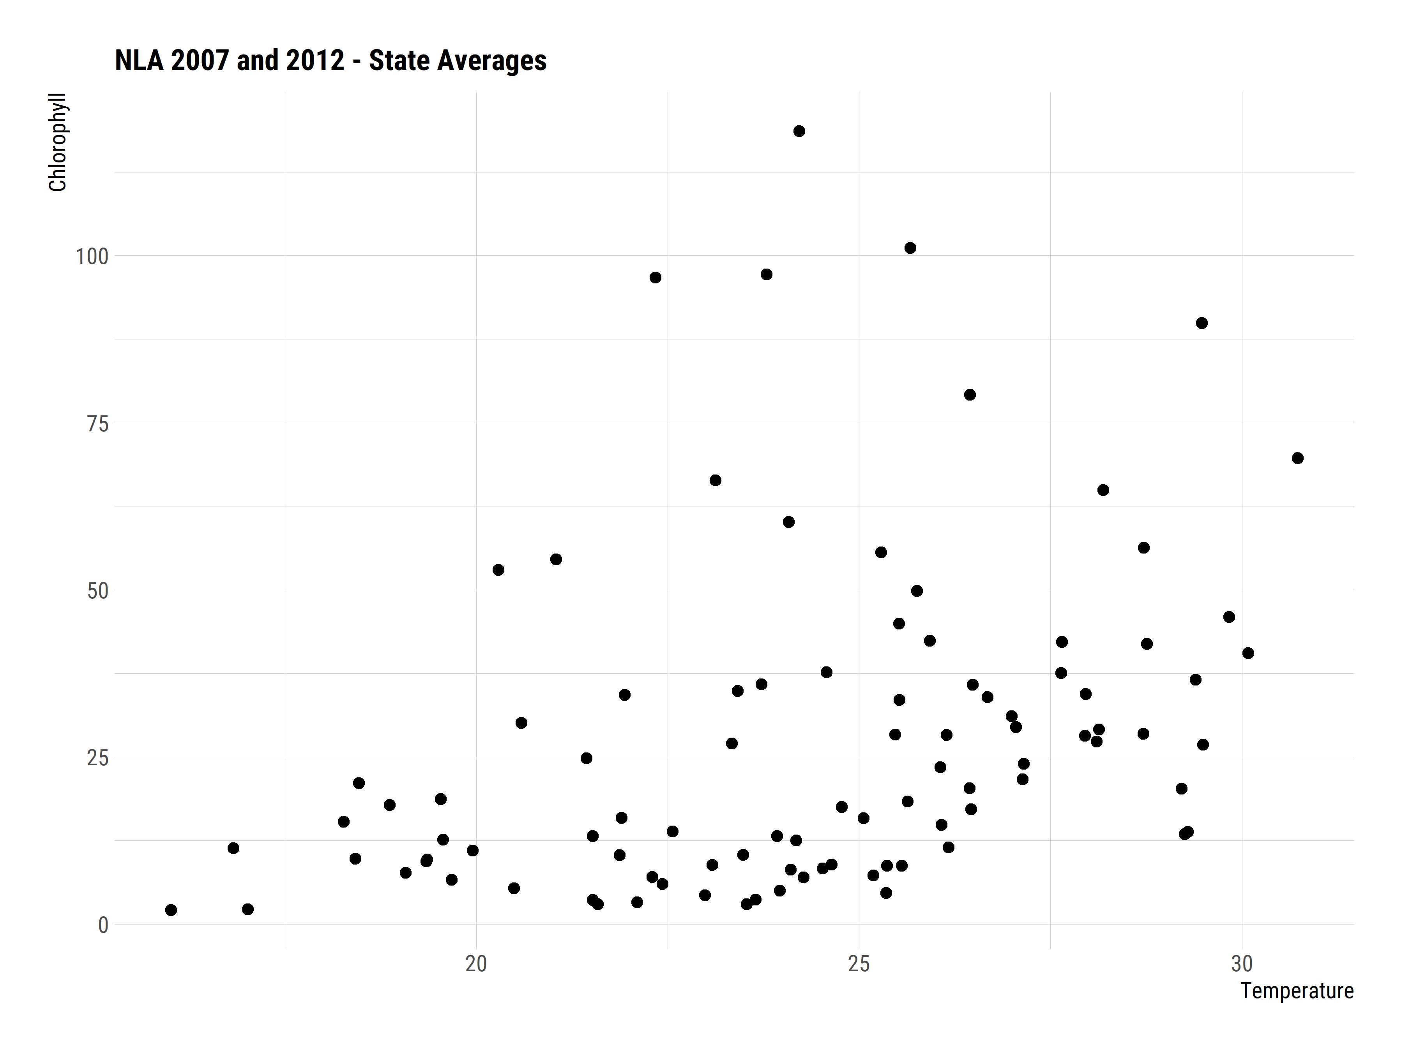
What drives changes in lake productivity?
Nutrients
Temperature
Other things

Slide 4
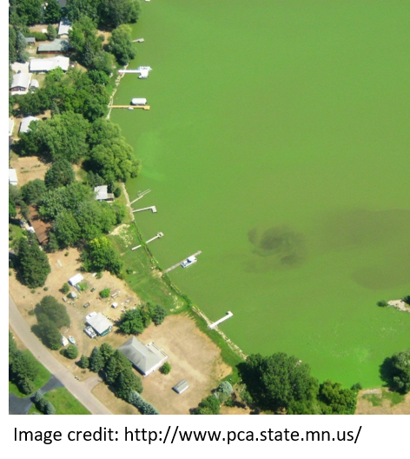
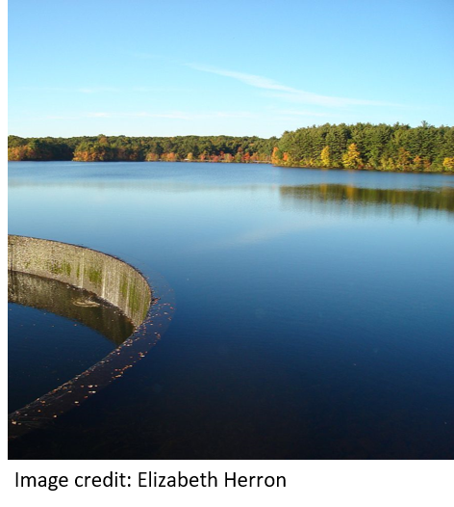
The management problem
Desire to reduce and manage nutrient pollution
Phosphorus Bans
Nutrient Criteria
Enacted piecemeal over last ~20 years
Do the data show any change?

Slide 5
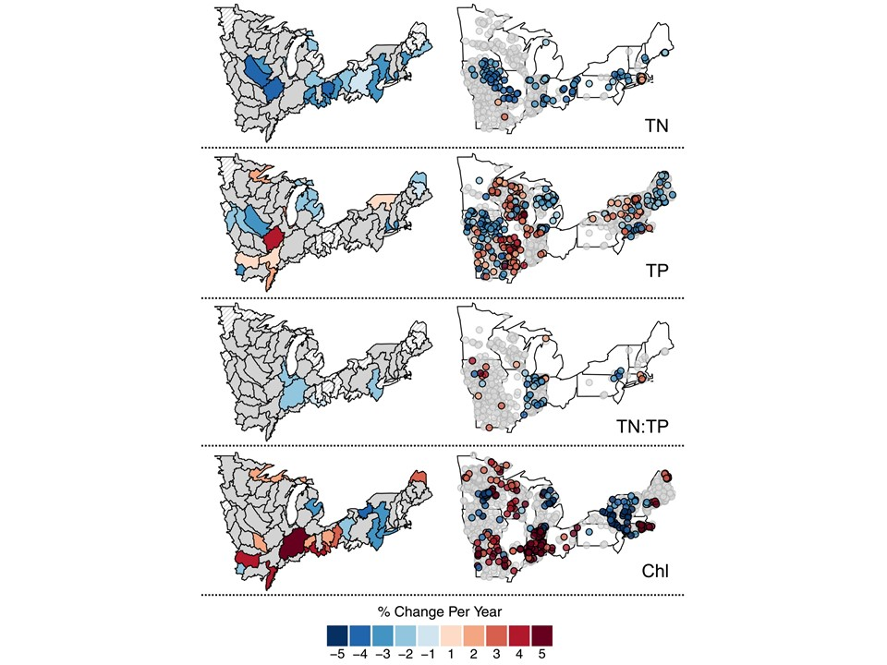
Stasis in Northeast
Oliver et al (2017) Unexpected stasis in a changing world: Lake nutrient and chlorophyll trends since 1990. Global Change Biology. DOI: 10.1111/gcb.13810

Slide 6
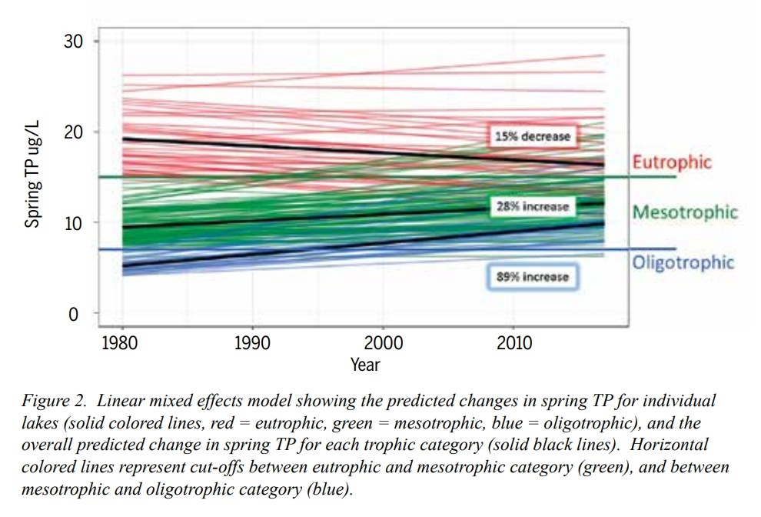
But change at other scales
Mathews et al (2018) Is Vermont losing its oligotrophic lakes?. LakeLine. 38-2.
Rhode Island?

Slide 7

URI Watershed Watch
Volunteer monitoring program
Started in 1988 with 14 lakes
Now
~400 volunteers
250+ sites
120+ waterbodies
Rigorous QA/QC
Data used by RI DEM and US EPA

Slide 8
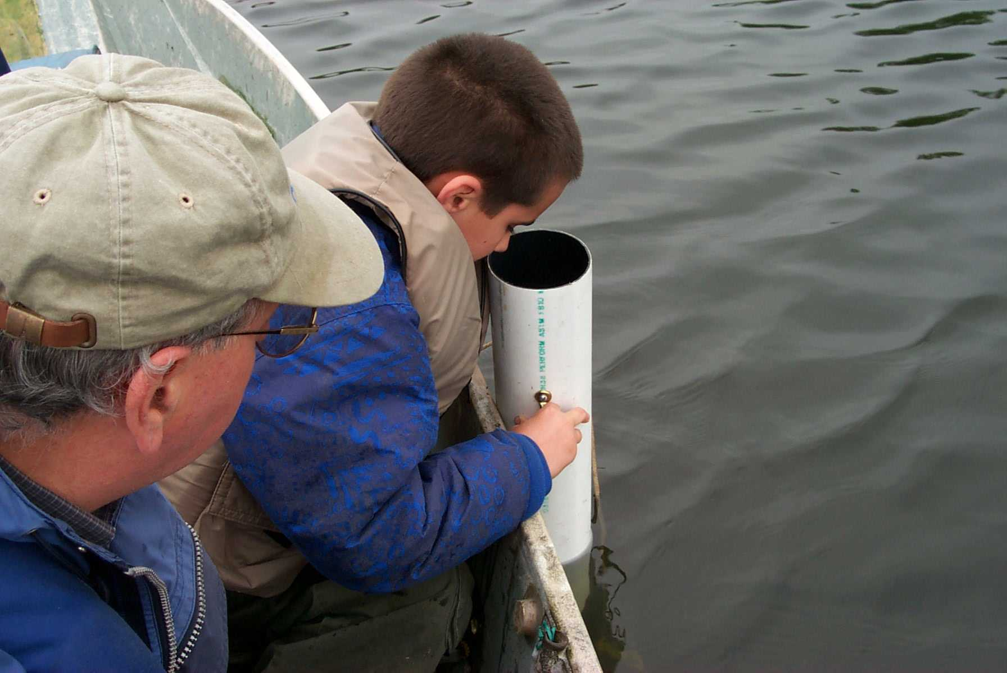
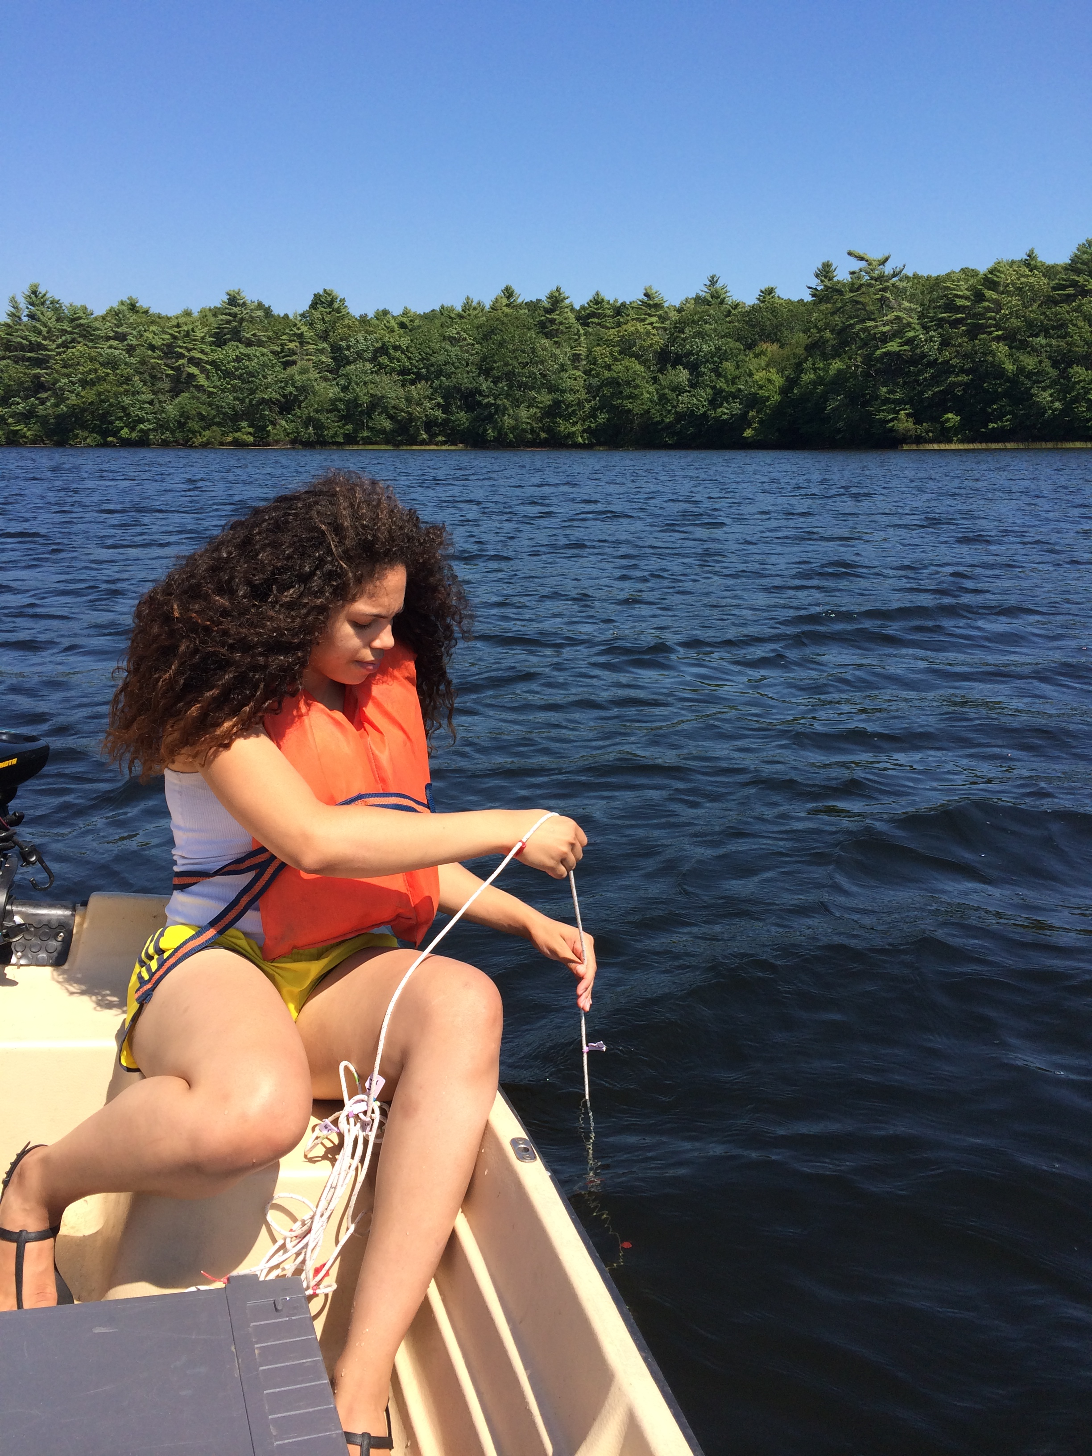
URI Watersehd Watch: Lake Sampling
May to October
Weekly
Water Clarity
Temperature
Every Other Week
Chlorophyll
Dissolved Oxygen
3 Times per Season
Nutrients
Alakalinity
pH
Bacteria

Slide 9
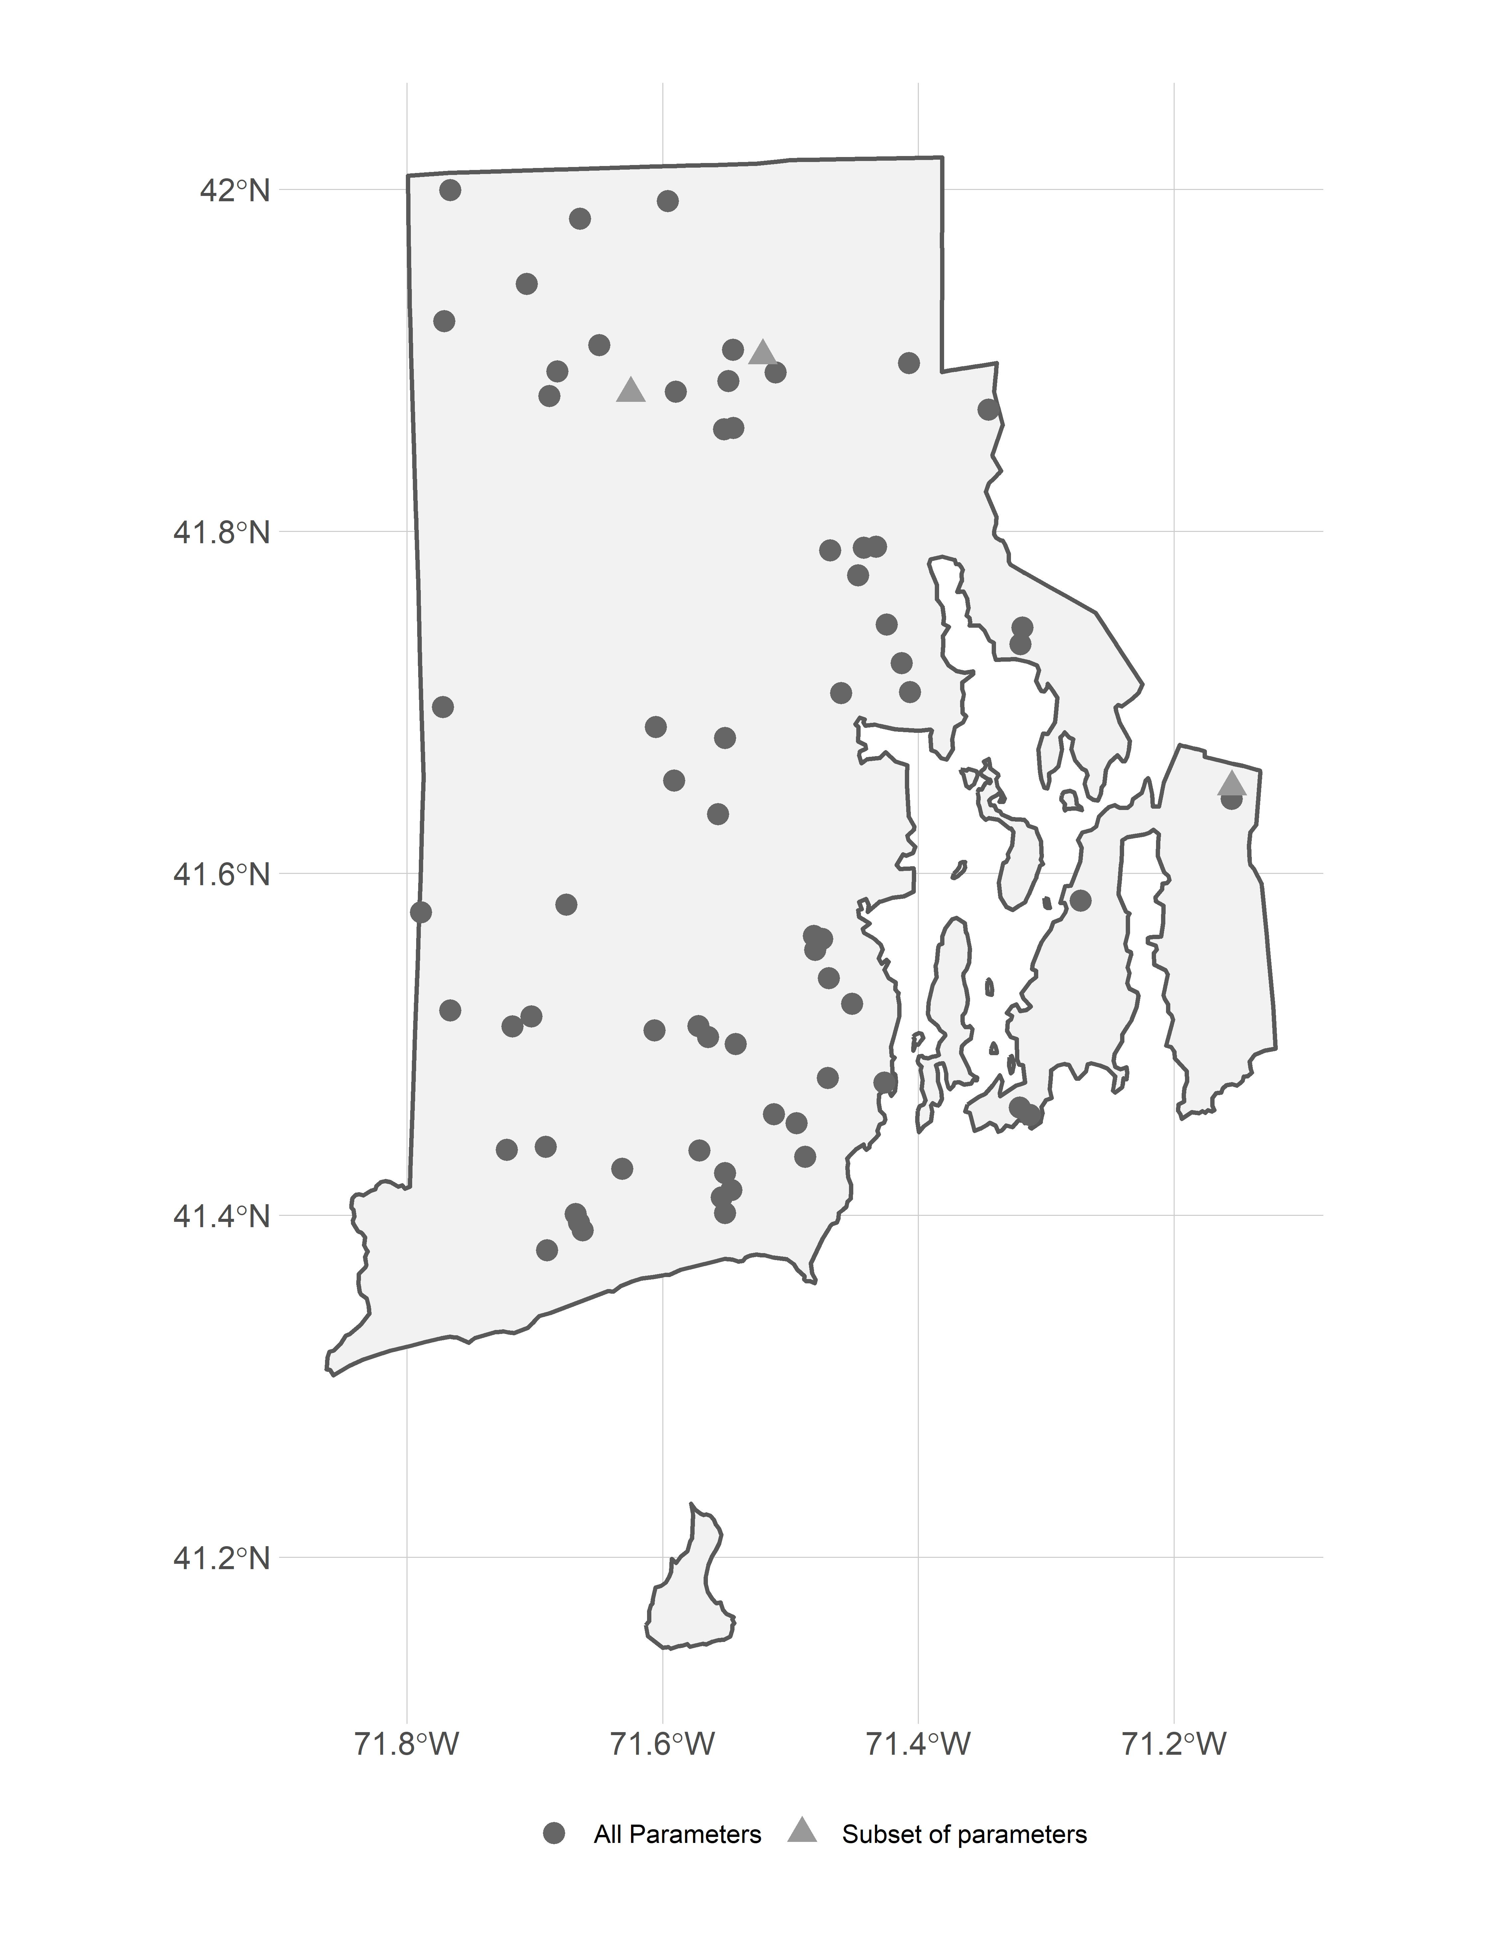
URI Watershed Watch: Filtered for Trend Analysis
Parameters:
Total Nitrogen, Total Phosphorus, N:P, Temperature, Chlorophyll
Years:
1993 to 2016
Months:
May through October
Depths:
<= 2 meters
Sites:
At least 10 years of data
Total of 69 Sites
66 with all parameters
1 without N (and N:P)
2 without chlorophyll and temperature

Slide 10
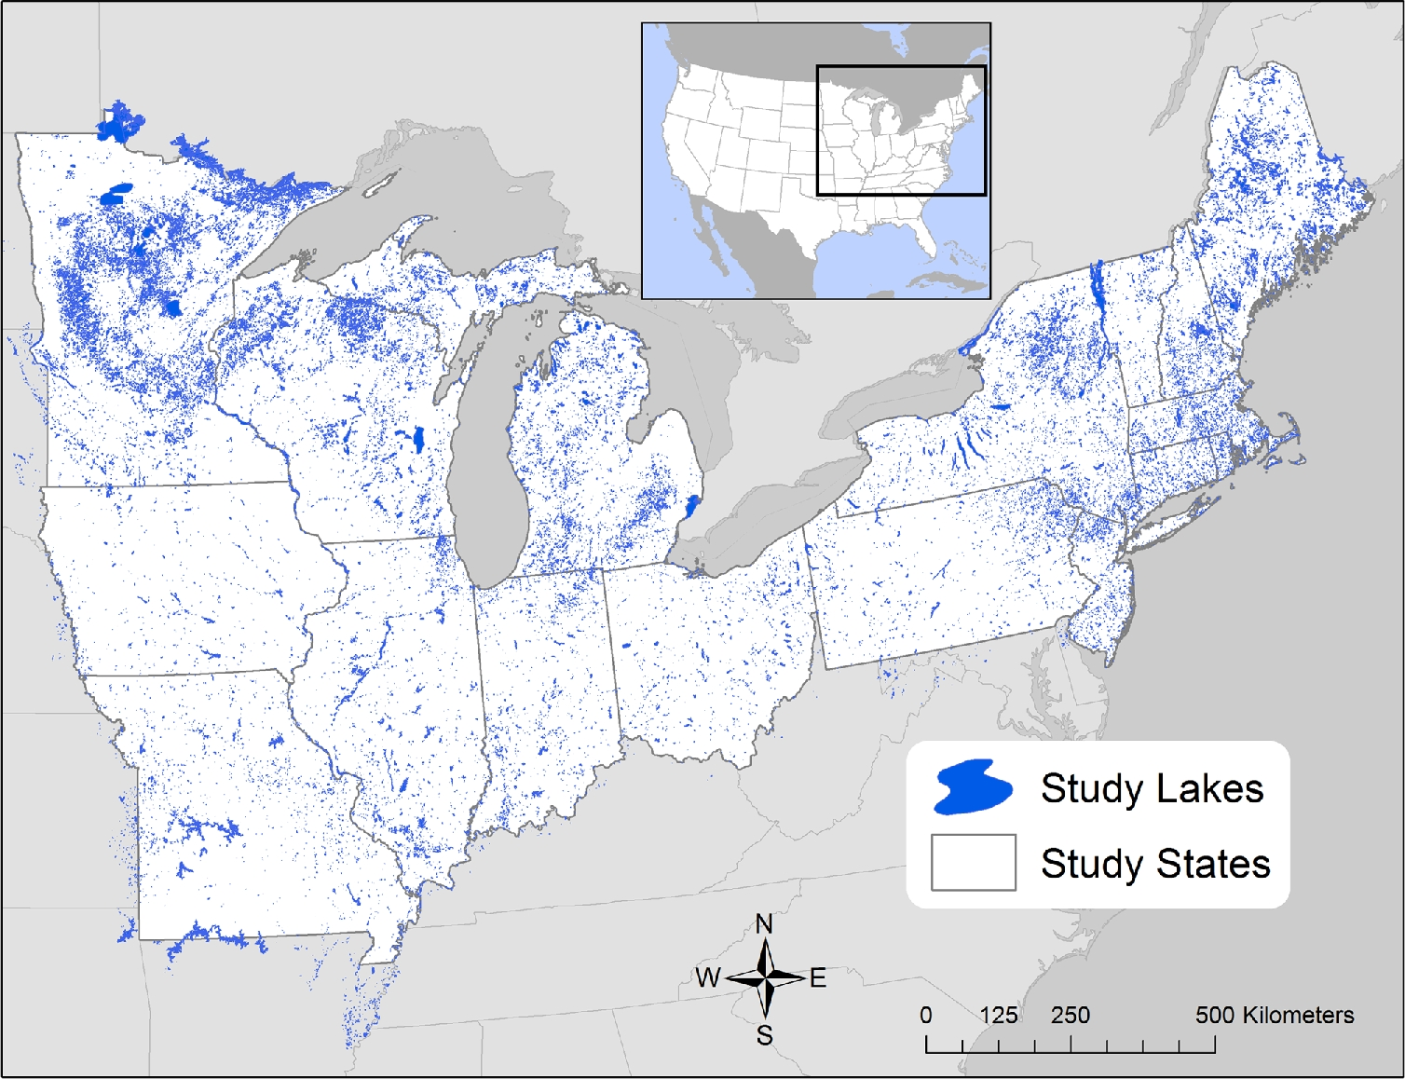
LAke mult-scaled GeOSpatial and temoporal database
Soranno et al (2017). LAGOS-NE: a multi-scaled geospatial and temporal database of lake ecological context and water quality for thousands of US lakes. Gigascience, 6(12)
Stachelek and Oliver (2017). LAGOSNE: Interface to the lake multi-scaled geospatial and temporal database. R package version 1.1.0. https://cran.r-project.org/package=LAGOSNE
17 States:
CT, IL, IN, IA, ME, MA, MI, MN, MO, NH, NJ, NY, OH, PA, RI, VT, WI
~ 50,000 Lakes

Slide 11
LAke mult-scaled GeOSpatial and temoporal database: Filtered for Trend Analysis
Parameters: Total Nitrogen, Total Phosphorus, N:P, Chlorophyll
Temperature data not currently available
Years: 1993 to 2016
Months: May through October
Depths: <= 2 meters
Sites: At least 10 years of data
Total of 1482 Sites
637 with chlorophyll and phosphorus
377 with only chlorophyll
275 with only phosphorus
161 with all variables (except temperature)
25 with chlorophyll and nitrogen
7 with other combination of nutrients

Slide 12
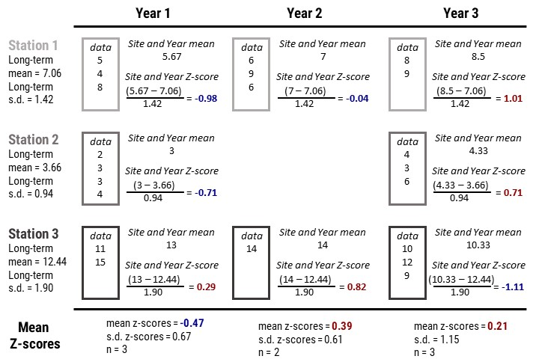
Analysis: Site-specific z-scores and yearly trends
Similar to temperature anomalies used to look at global temperature change
Calculate average yearly z-score
Look for monotonic yearly trend
Slope of regression line

Slide 13
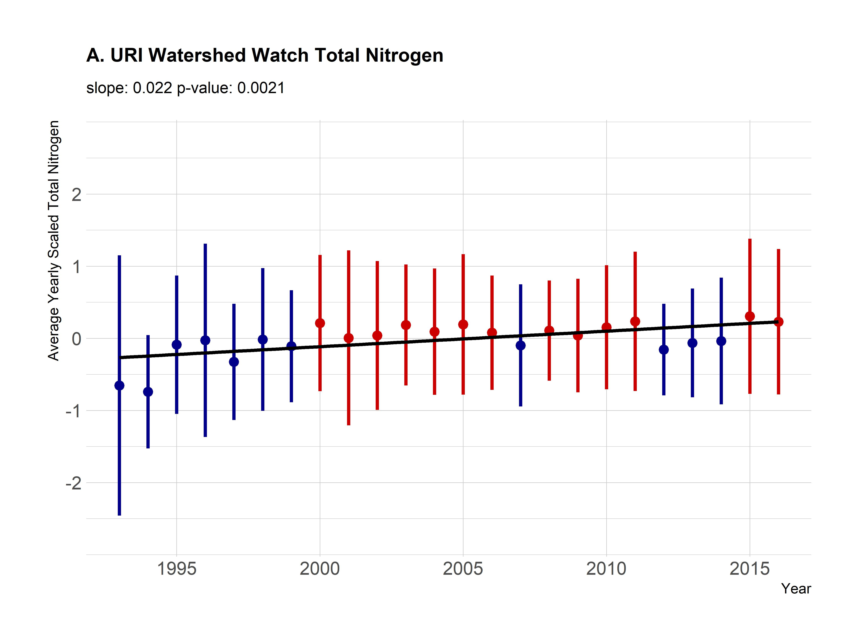
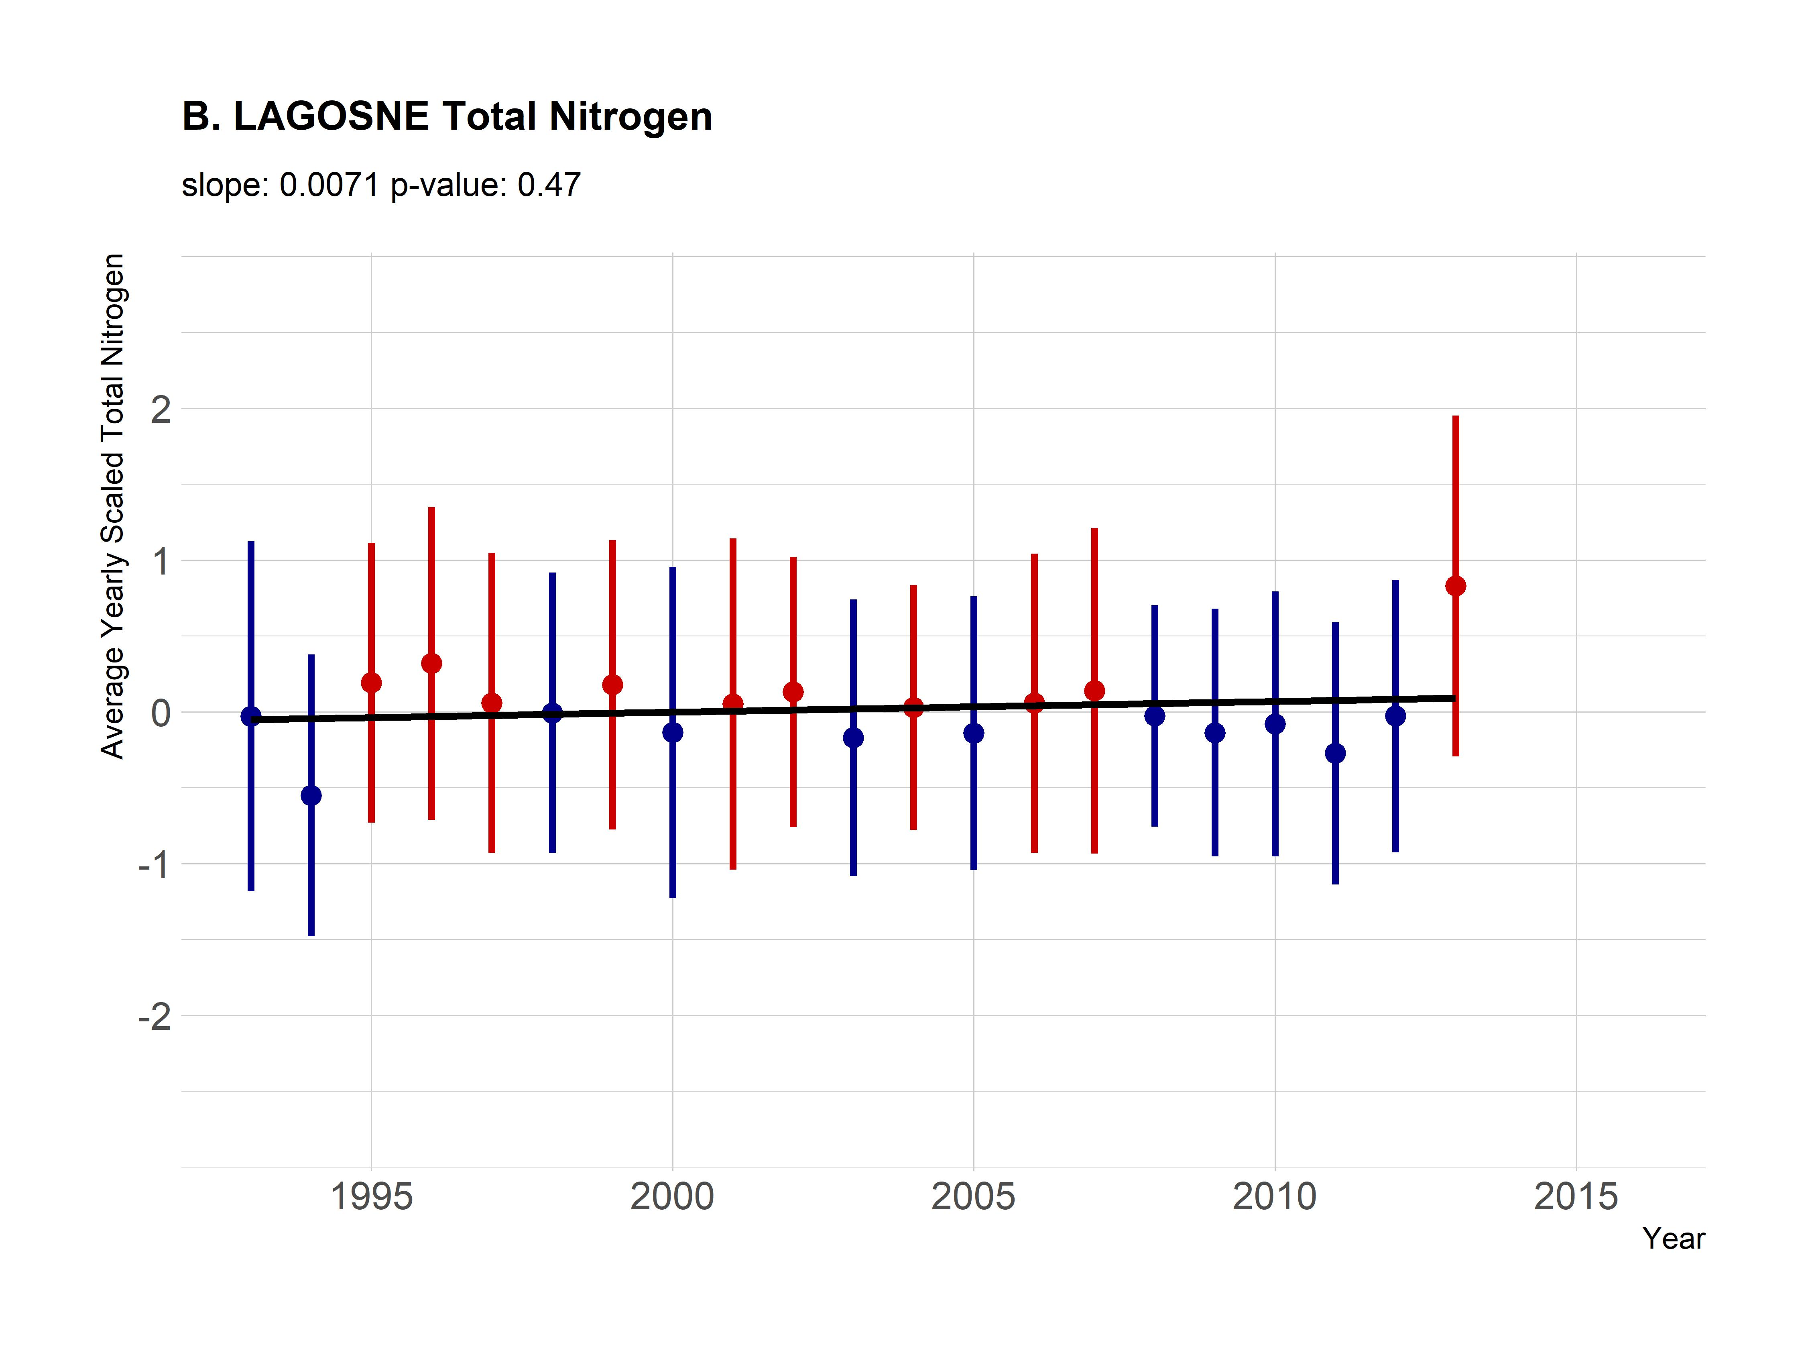
Results: Nitrogen trends
RI: Increasing but driven by low years in 1993 and 1994
Without those years slope = 0.01 and p-value = 0.06
LAGOSNE: Static
Points are averages and ranges are standard deviations with blue indicating an average below the long-term mean and red indicating an average above the long-term mean.

Slide 14
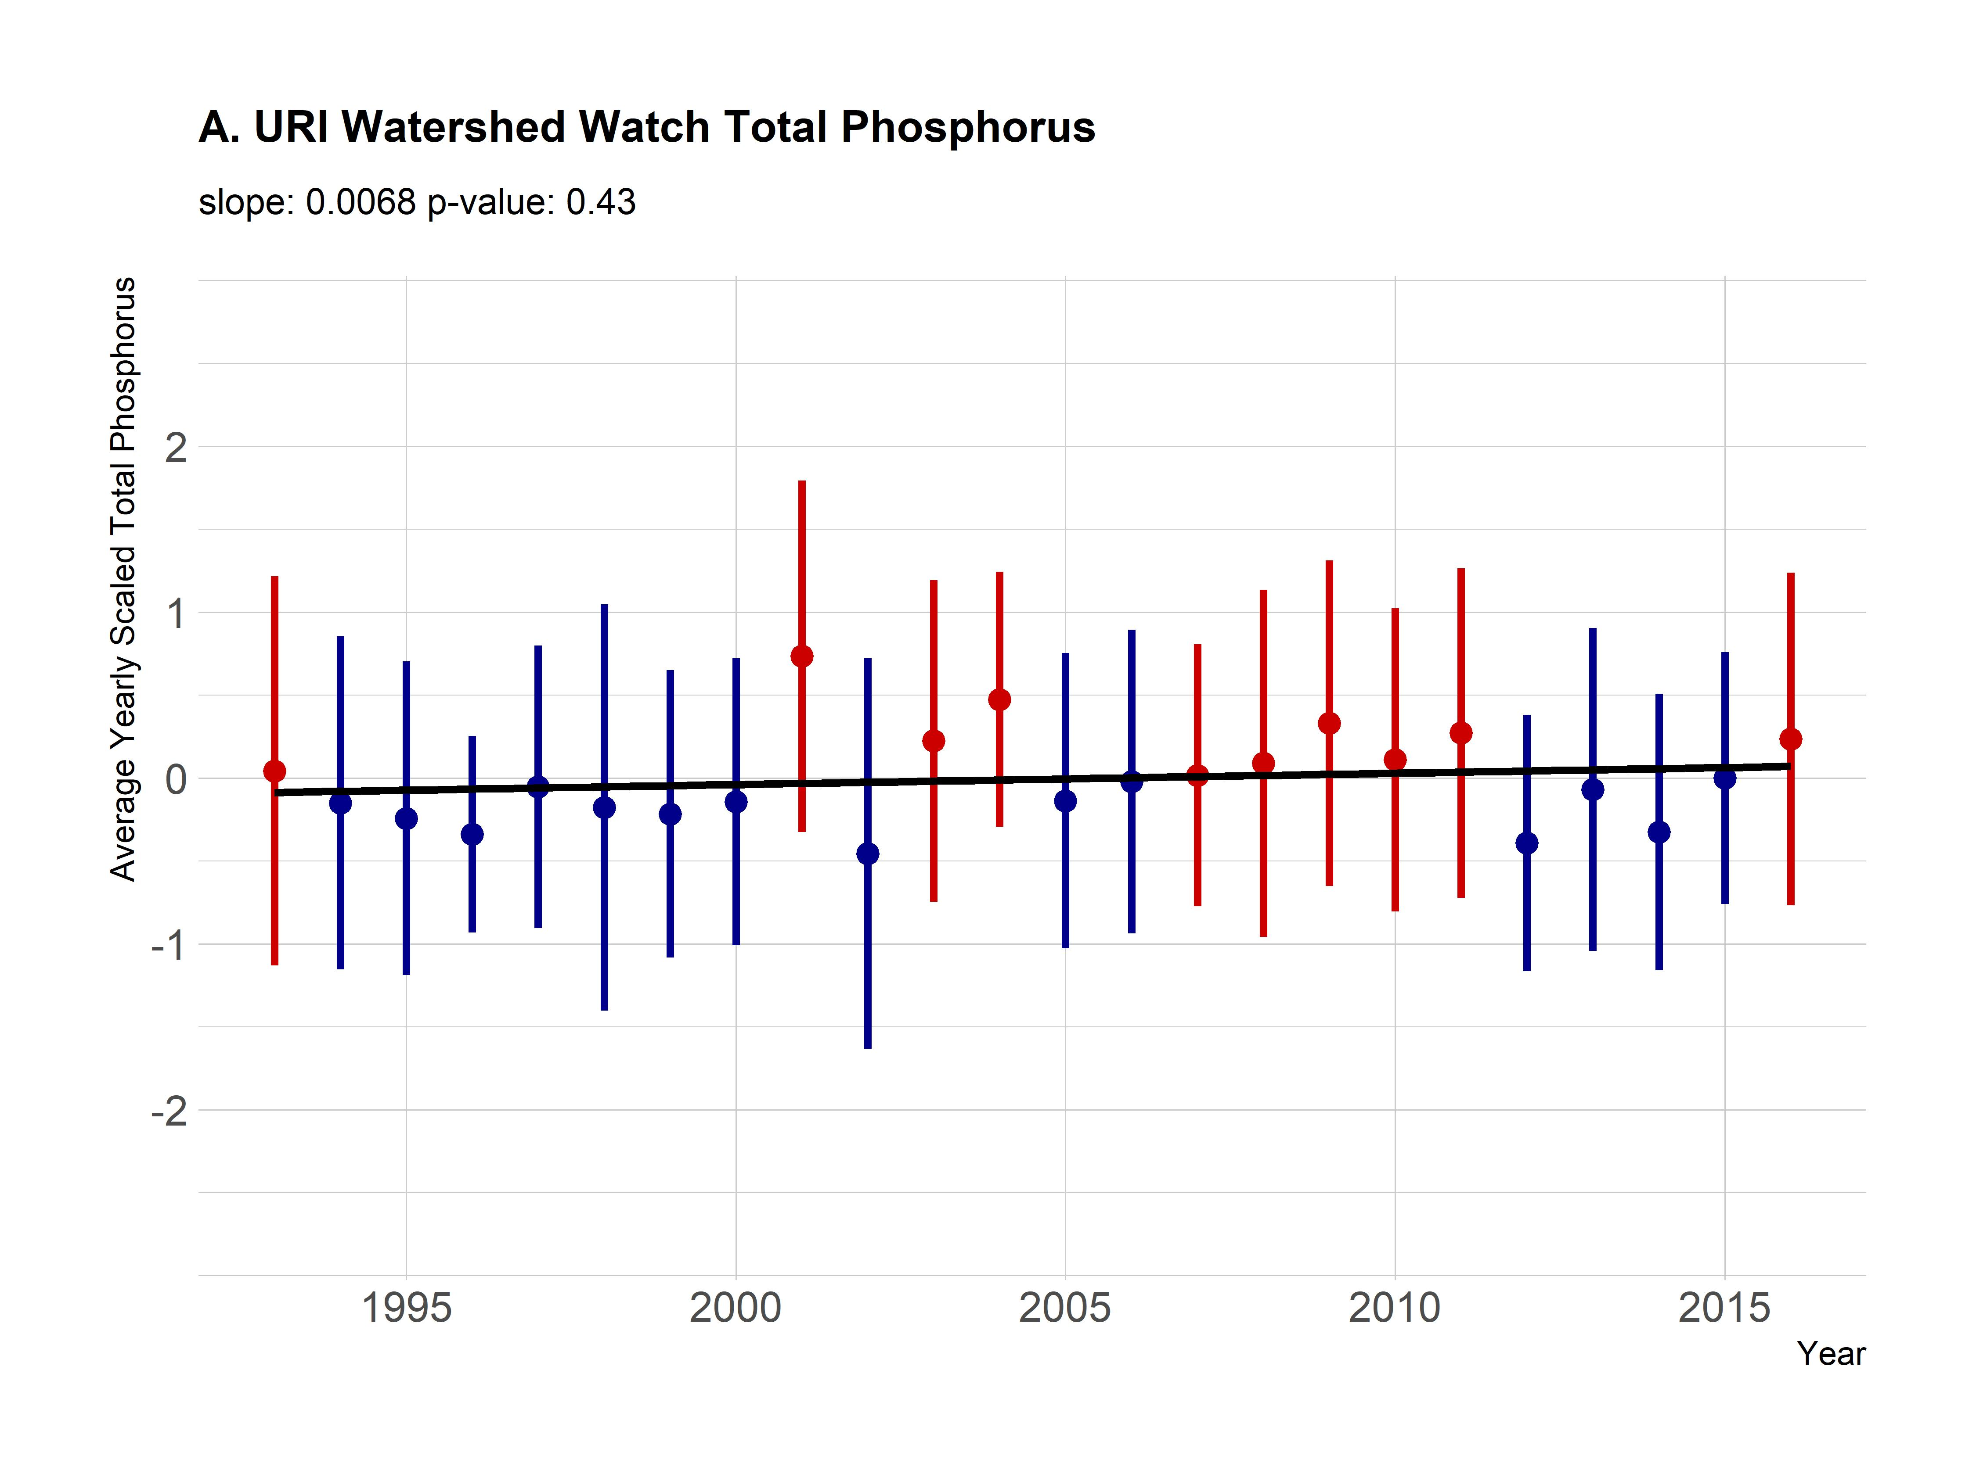
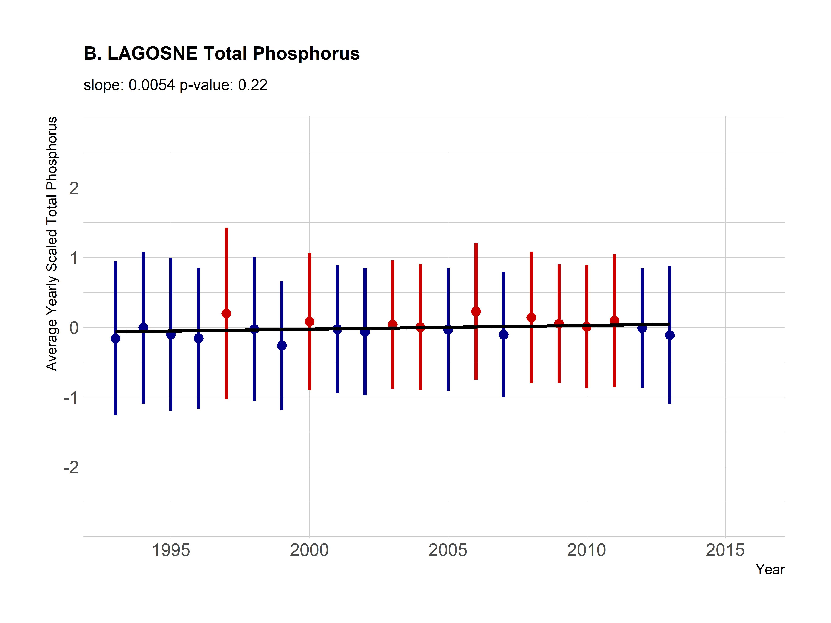
Results: Phosphorus trends
RI: Static
LAGOSNE: Static
Points are averages and ranges are standard deviations with blue indicating an average below the long-term mean and red indicating an average above the long-term mean.

Slide 15
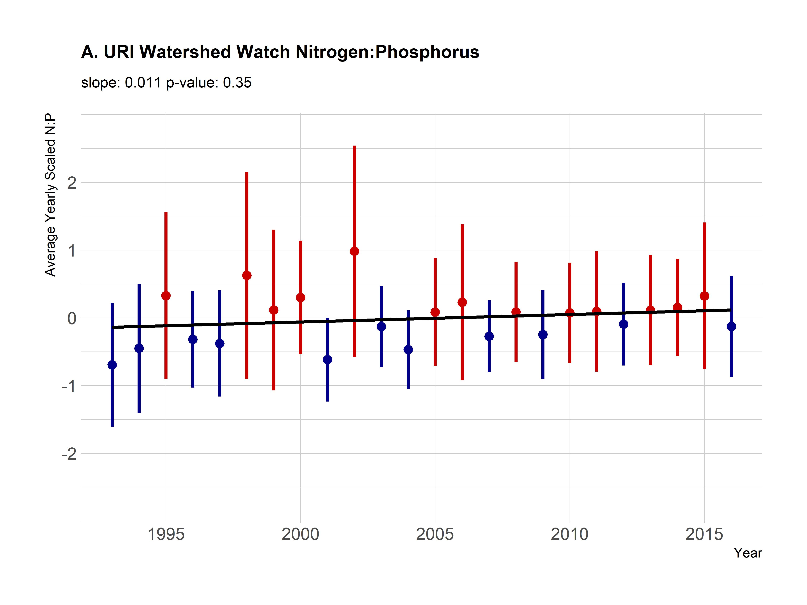
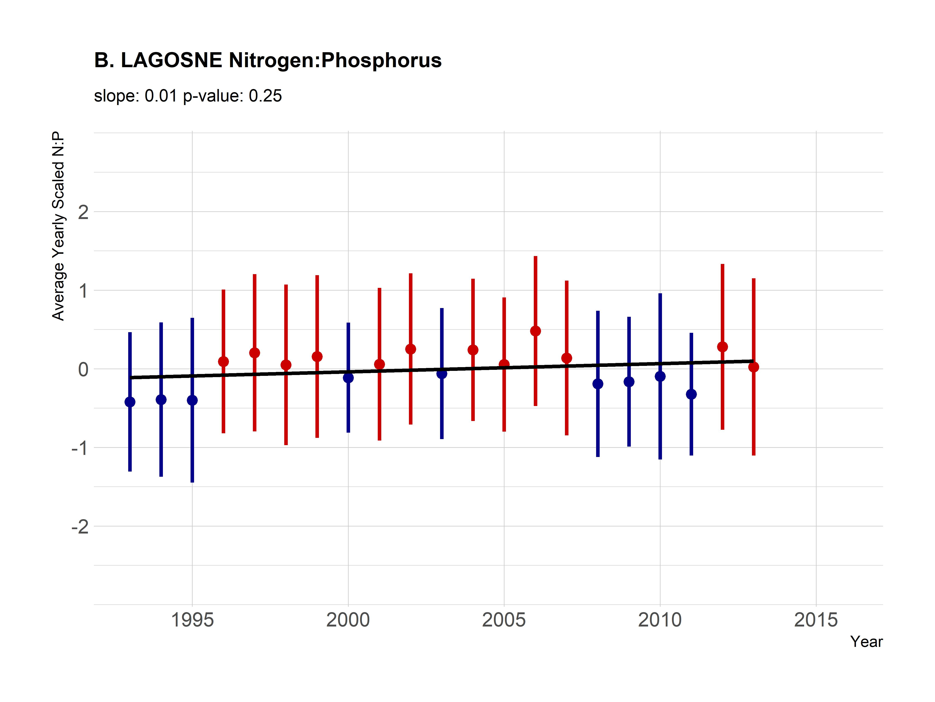
Results: N:P trends
RI: Static
LAGOSNE: Static
Points are averages and ranges are standard deviations with blue indicating an average below the long-term mean and red indicating an average above the long-term mean.

Slide 16
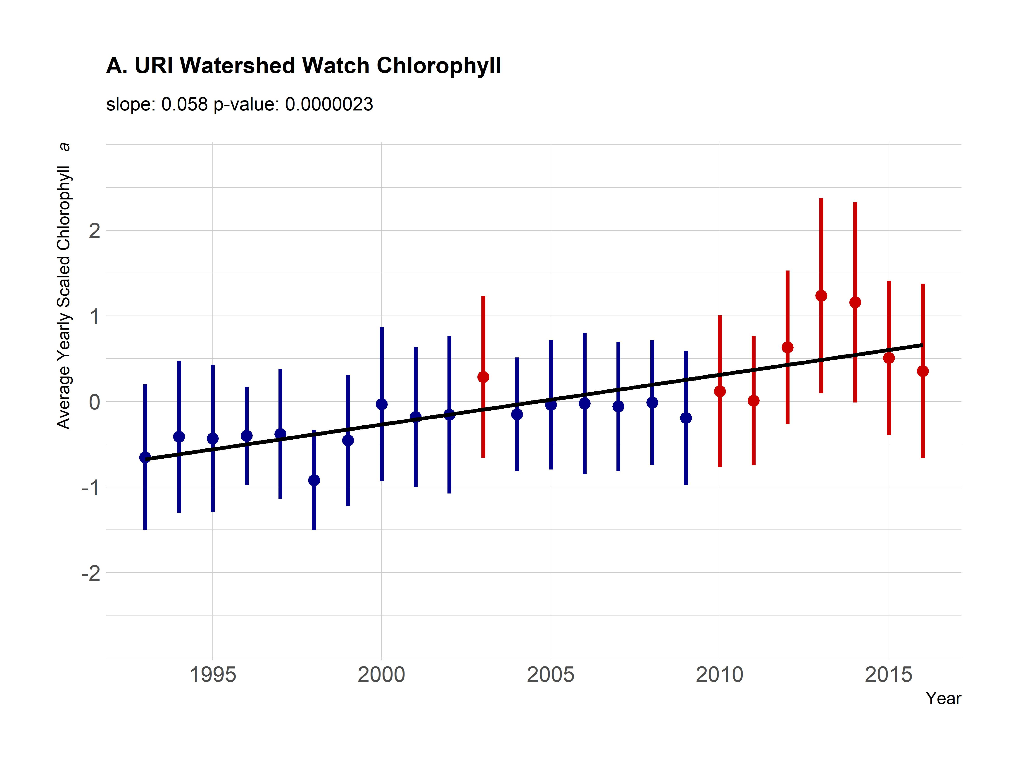
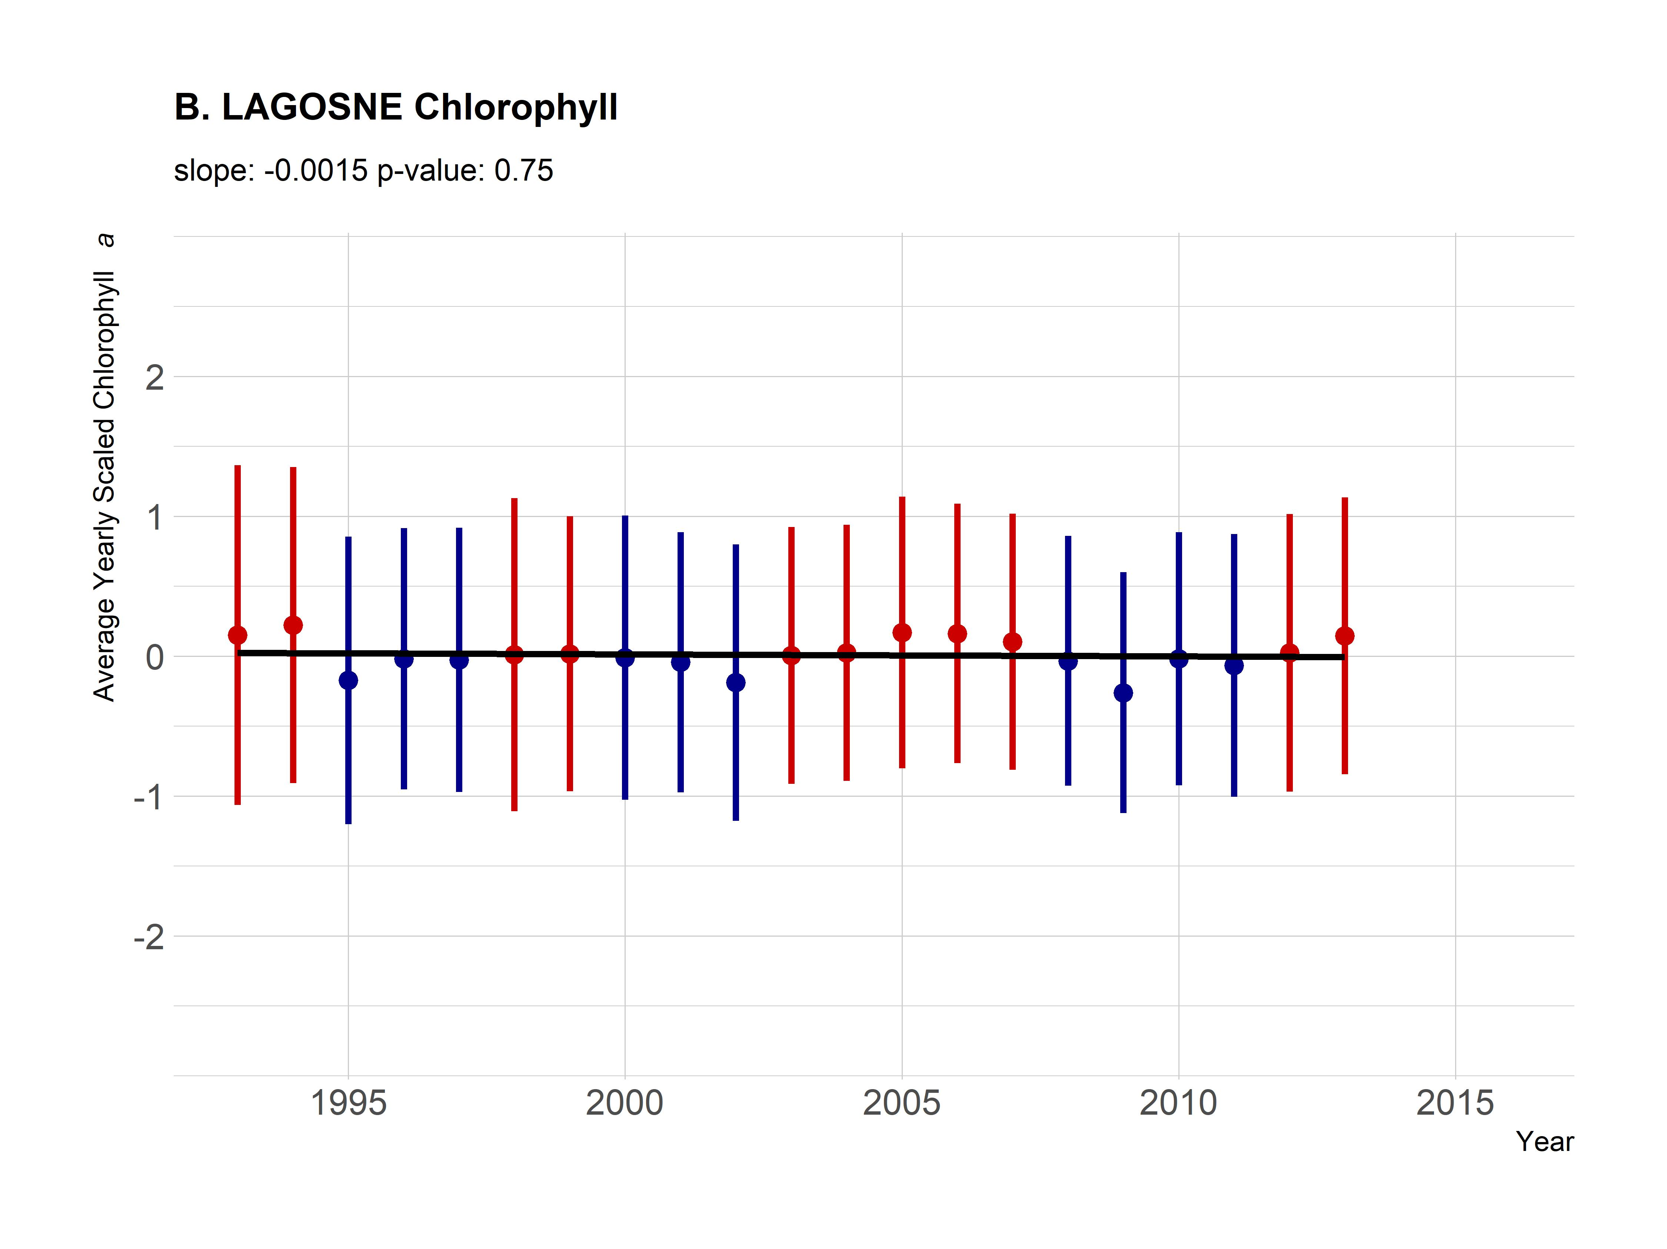
Results: Chlorophyll trends
RI: Increasing
LAGOSNE: Static
Points are averages and ranges are standard deviations with blue indicating an average below the long-term mean and red indicating an average above the long-term mean.

Slide 17
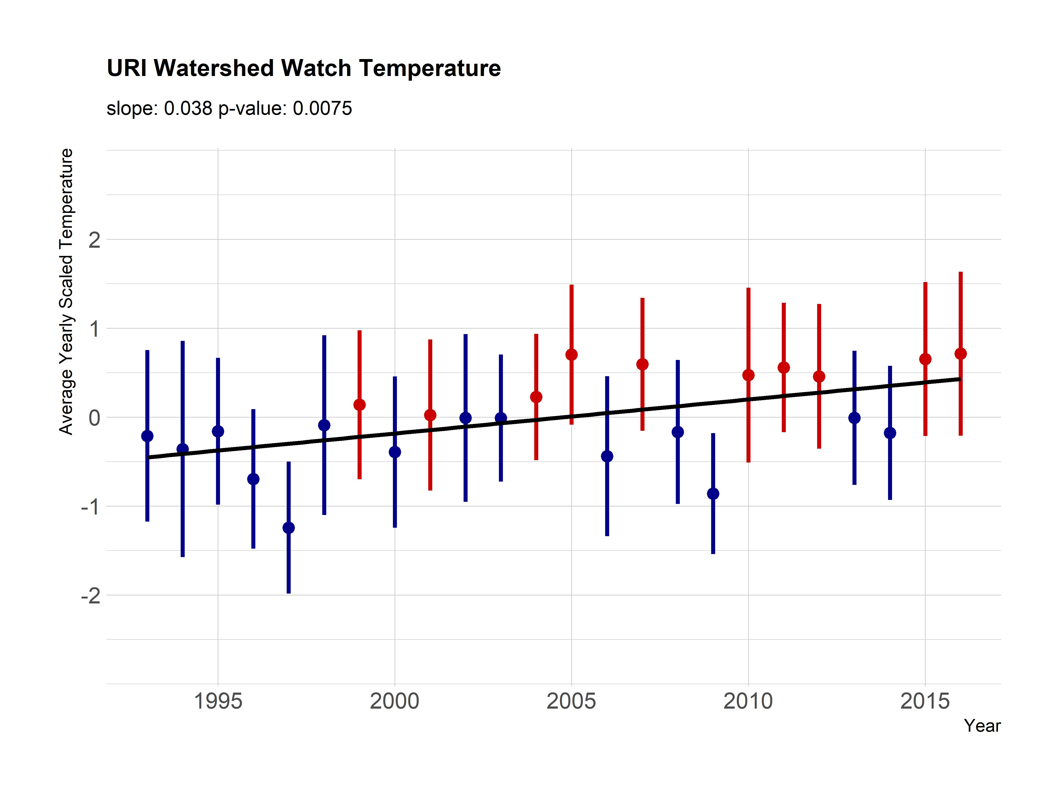
Results: Temperature trends
RI: Increasing
LAGOSNE: NA
Points are averages and ranges are standard deviations with blue indicating an average below the long-term mean and red indicating an average above the long-term mean.

Slide 18
Conclusions
In Rhode Island
More chlorophyll
More heat
Nutrients not changing much
Within the Northeast
Stasis
Our results concur with Oliver et al. (2017)

Slide 19
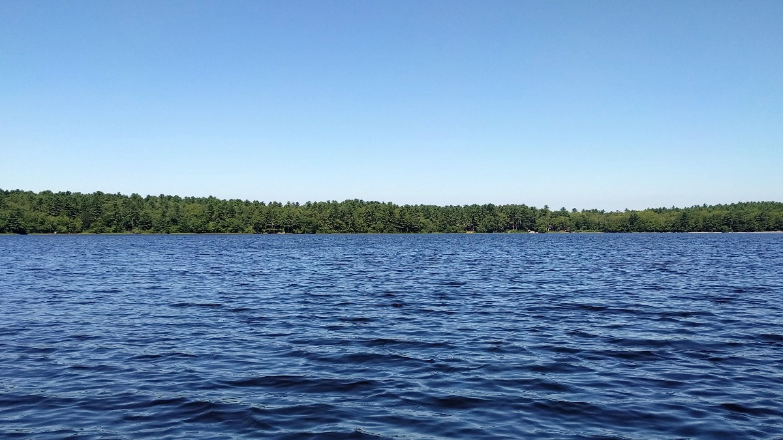
Thank you and Questions
Jeff Hollister
hollister.jeff@epa.gov
401 782 9655
@jhollist

